Slide 1
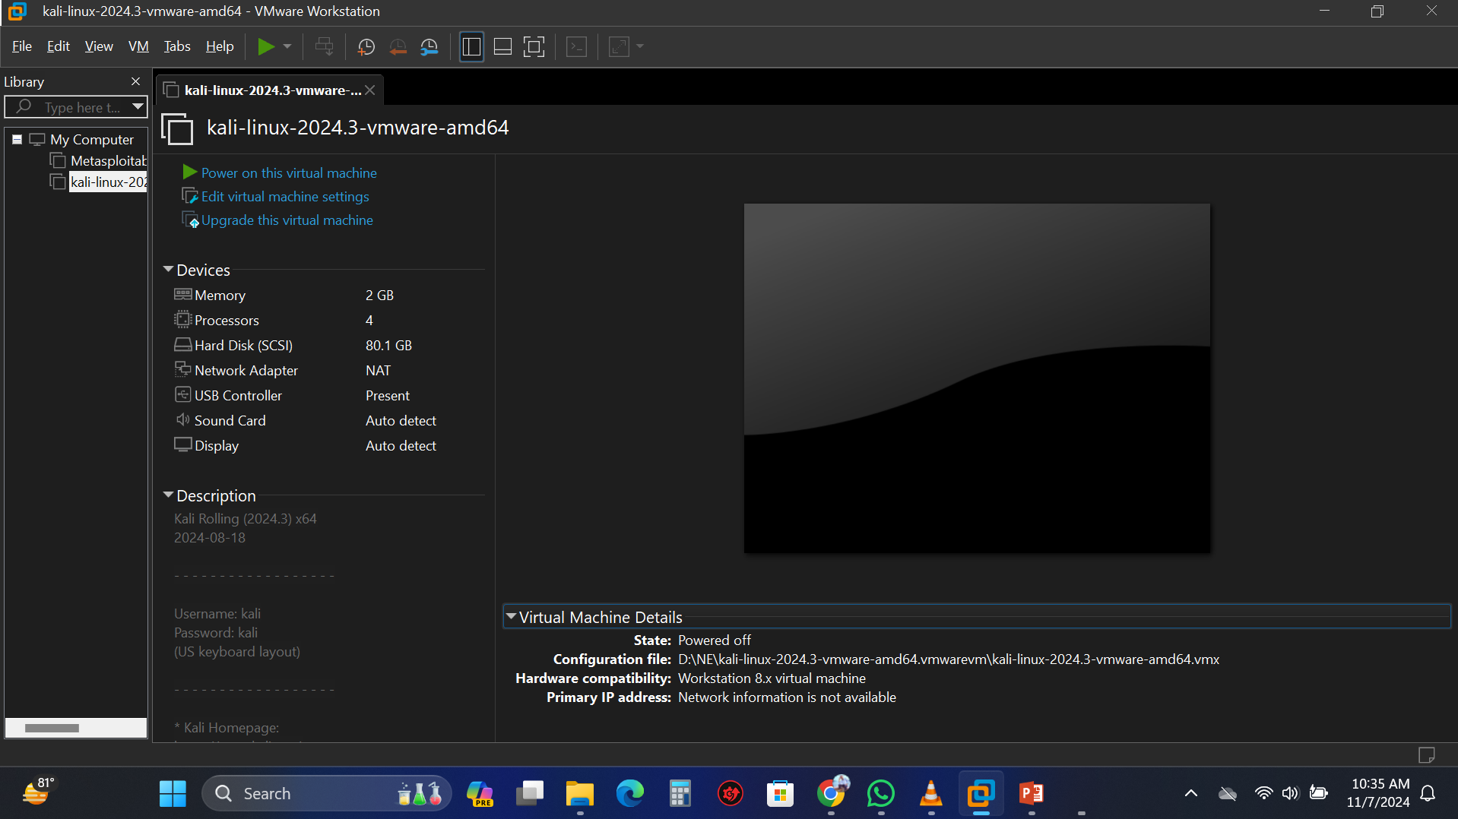
Port Scanning
Open VmWare Work Station and Power on Kali Linux.

Slide 2
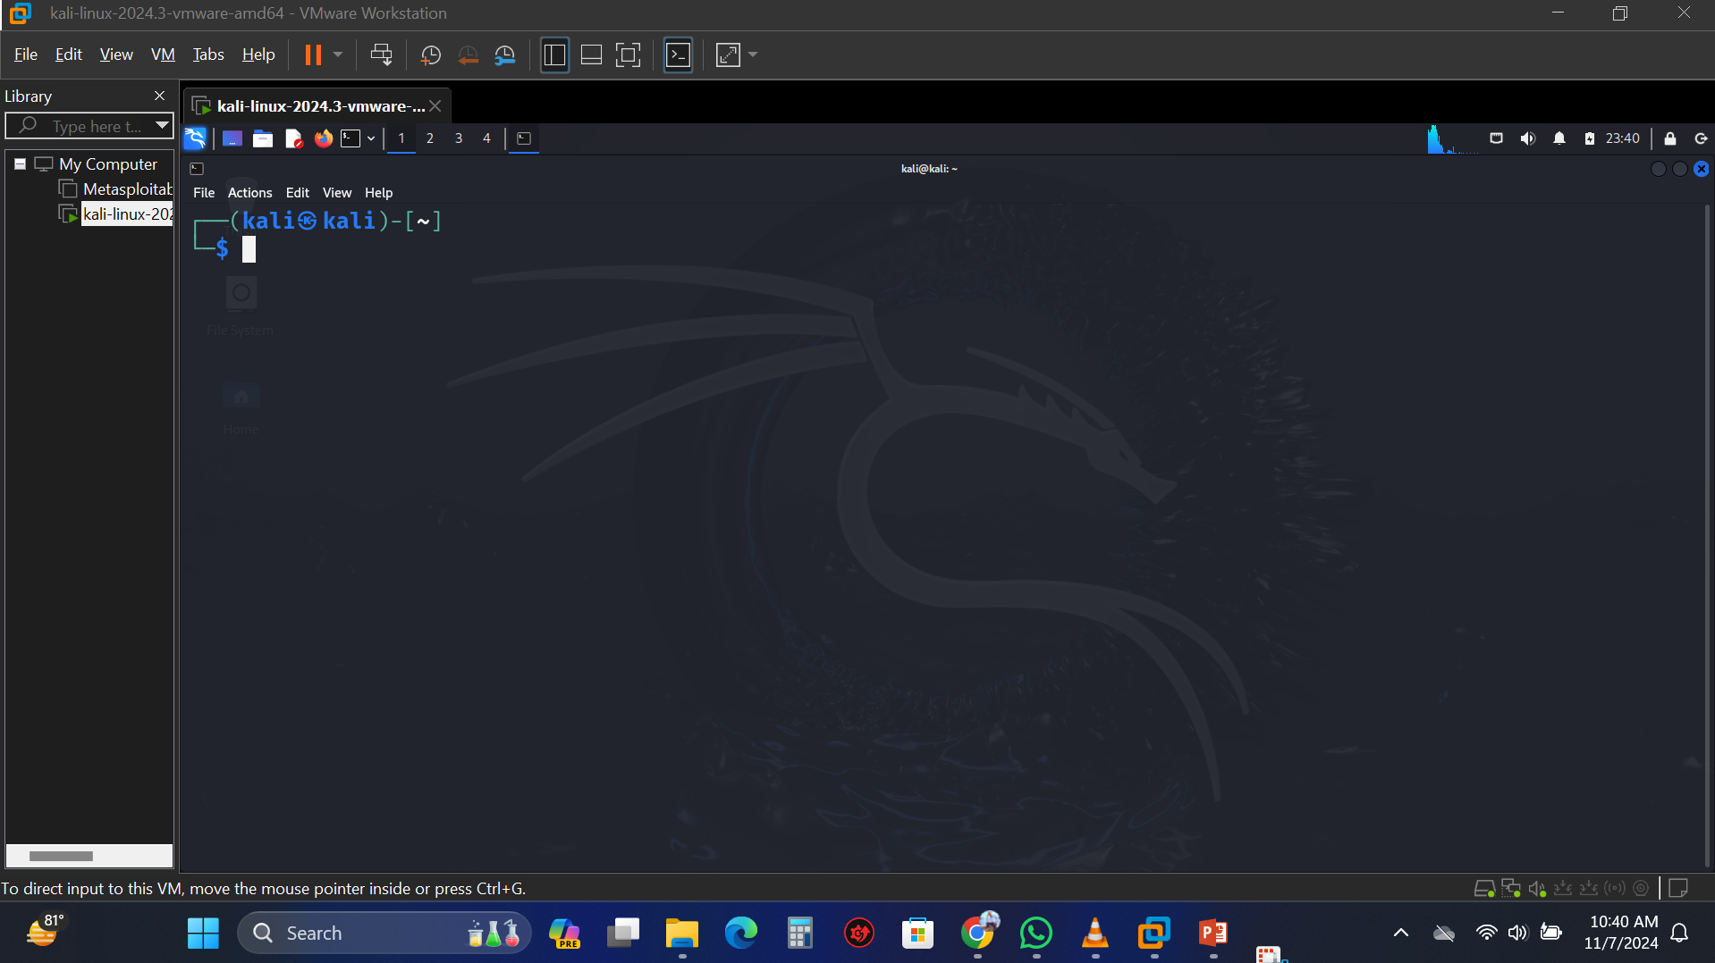
Open Terminal in Kali Linux.

Slide 3
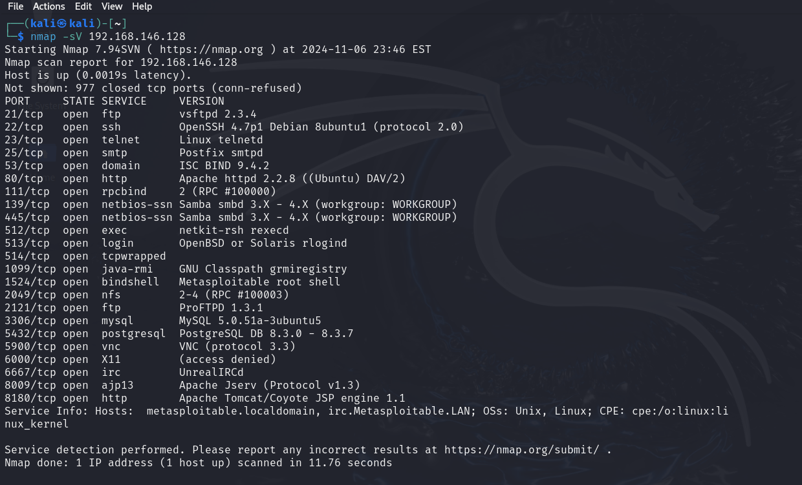
Type Command nmap –sV (Targets IP) and press ENTER.

Slide 4
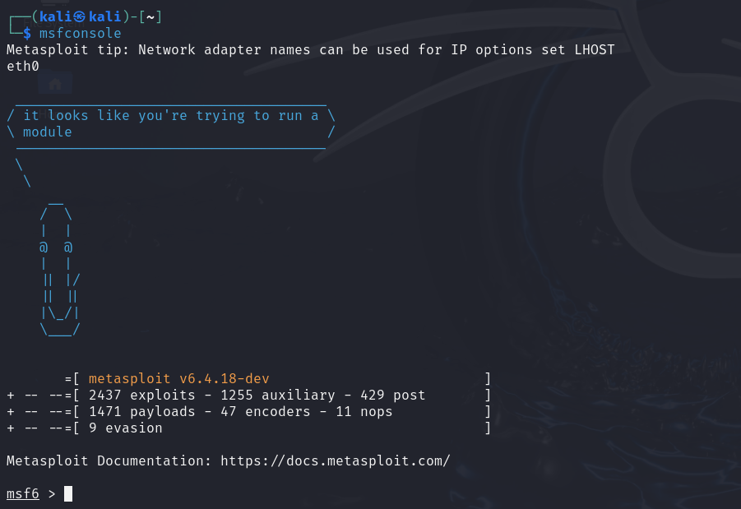
Type Command msfconsole and Press Enter.

Slide 5
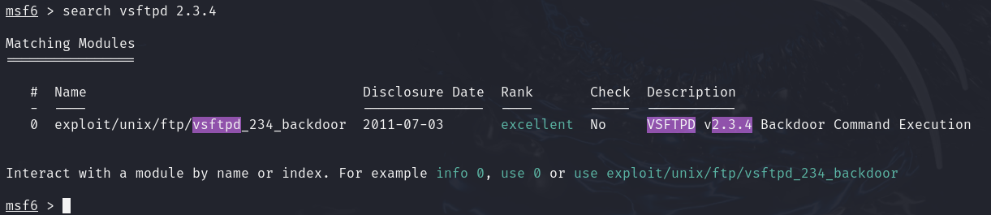
Type Command search (copy any TCP ports version from previous step for search backdoor vulnarebility) and press Enter.

Slide 6
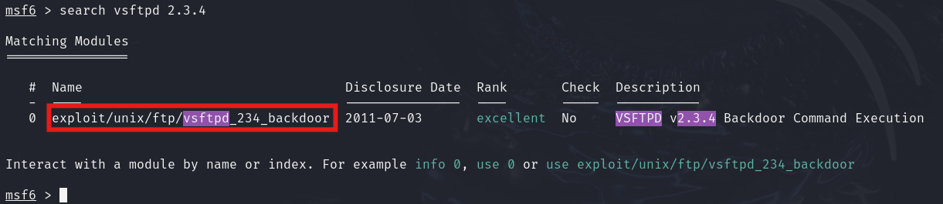
Copy Backdoor Name from matching module.

Slide 7
Type command Use (Backdoor Name for Access).

Slide 8
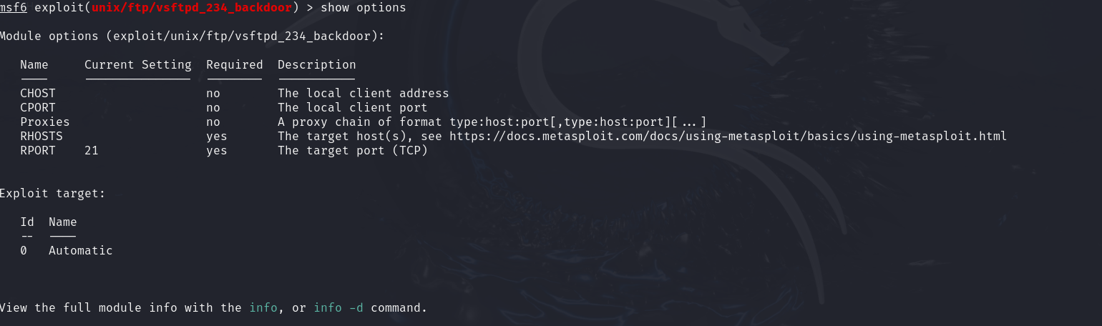
Type Command show options and press Enter to see module options.

Slide 9
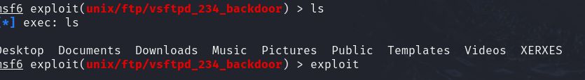
Type command exploit and press Enter.
Type command ls and press Enter to see target systems options.

